Slide 1

Events handling with JavaScript

Slide 2
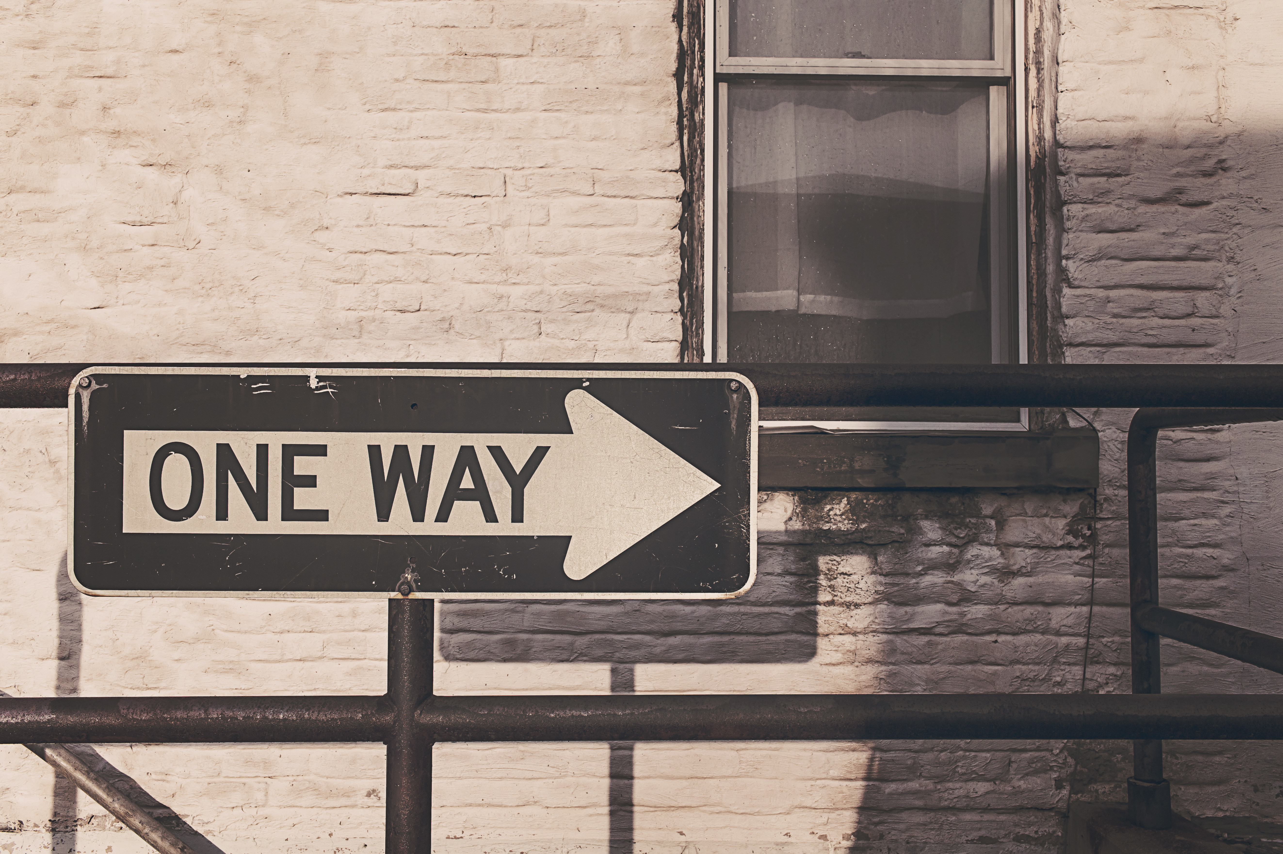

Slide 3
Event Phases
Window
CAPTURE
BUBBLING
Document
<HTML>
<BODY>
<HEADER>
<DIV>
<DIV>
<A>
<A>
TARGET

Slide 4
Event object
Properties
target
timeStamp
isTrusted
Methods
preventDefault
stopPropagation

Slide 5
Event Listener
addEventListener();
removeEventListener();
htmlRef.addEventListener( ‘click’ , handler , false );
htmlRef.removeEventListener( ‘click’ , handler);

Slide 6
Event handler
function handler(){
this => object, html reference
event => object, event configuration
}

Slide 7
Existing issues
No html reference
No reference to other events
Not testable
Easy to get it wrong

Slide 8
Common mistakes
Using onEvent handlers
Attaching/detaching in a loop
Lambda expression
Libraries madness
Easy to get it wrong

Slide 9
Best practices
One event listener
Event delegation
Map events to methods
Named functions
Prepare events up front

Slide 10


Slide 11
Write your own!
Wut?

Slide 12
Desired features
Get all attached events
Check for specific event
Detach all or specific events
Trigger events
Testable

Slide 13
Sample syntax
UIEvent({
name: 'Event name',
htmlRef: htmlRef,
handler: function(){ alert( 'it works' ); },
type: 'click'
});

Slide 14
DEMO

Slide 15
Resume
What is JS Event
Bad/Good practices
Alternatives

Slide 16
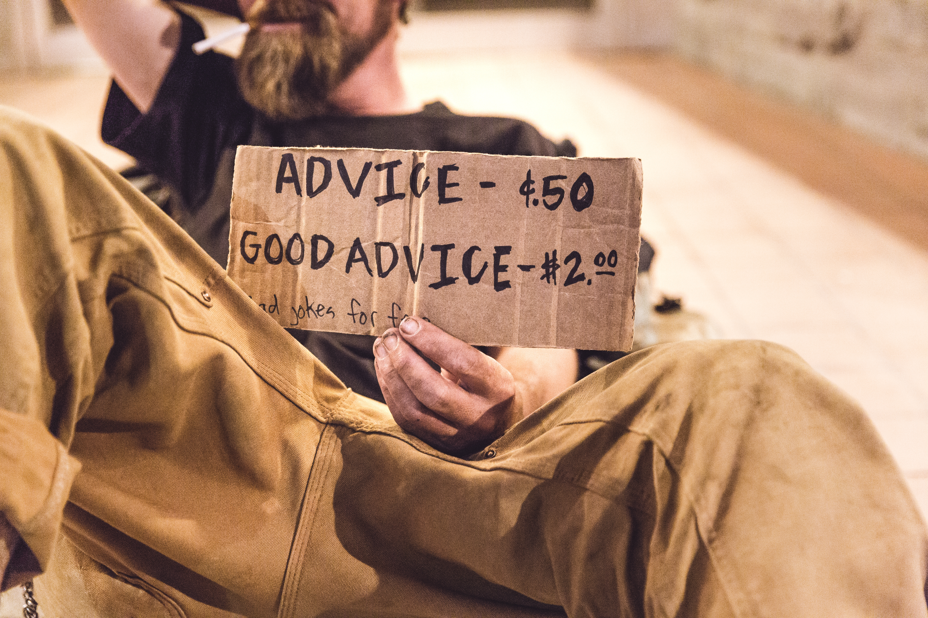
Questions?

Slide 17
Thank you!
https://goo.gl/RBU1Sm
martin@mchaov.net
http://lnkd.in/deXfH5p

